Slide 1
Upcoming changes in the EU Nuclear Waste Directive and how to raise your voice
Online event 2026-06-08
Gabriele Mraz, Austrian Institute of Ecology

Slide 2
Directive 2011/70/Euratom (“Nuclear Waste Directive”)
Goal: ensure responsible and safe management of spent fuel and radioactive waste to avoid imposing undue burdens on future generations
General principles (Art. 4)
Each member state has the ultimate responsibility for the management of spent fuel and radioactive waste that are generated in it. This responsibility remains with the member state also in case of shipments to another countries for reprocessing or processing
Each member state has to have a national policy for management of spent fuel and radioactive waste.
Radioactive waste shall be disposed of in the member state where it was generated, with the exception of agreed shipments to other countries

Slide 3
Evaluation of the implementation of the Nuclear Waste Directive
The „Joint Project – Nuclear Risk & Public Control” monitored the implementation since the first national waste management programmes were submitted (2015); we published regular reports until 2023
The European Commission/DG Ener evaluated the national programmes of the member states and published three reports on it:
  3rd report COM(2024)197 and its 2 staff working documents SWD(2024)123 and SWD(2024)127
  2nd report COM (2019) 362 and its 2 staff working documents SWD(2019)436 and SWD(2019)435
  1st report COM(2017)236 and its 2 staff working documents SWD(2017)159 and SWD(2017)161

Slide 4
Scope – what is in, and what should be in
Requirements of Directive 2011/70/Euratom
Art. 2 (1). This Directive shall apply to all stages of:
(a) spent fuel management when the spent fuel results from civilian activities;
(b) radioactive waste management, from generation to disposal, when the radioactive waste results from civilian activities.
Art. 2 (2): This Directive shall not apply to:
(a) waste from extractive industries which may be radioactive and which falls within the scope of Directive 2006/21/EC (“Extractive Waste Directive”, “Mining Waste Directive”)
Evaluation
1) Spent fuel and radioactive waste from military activities are not in the scope of the Nuclear Waste Directive.
2) Uranium mine and mill tailings (UMMT): Member states can choose if their UMMT are under the scope of Nuclear Waste Directive or not.
  Slovenia: At the site of the closed uranium mine at Žirovski Vrh are two disposal sites; both are in the national waste management programme under the Nuclear Waste Directive.
  Czech Republic: UMMT are under the Act on Mining Waste and Atomic Act but not in the national waste management programme under the Nuclear Waste Directive.

Slide 5
Scope – what is in, and what should be in
Commission Staff Working Paper: Situation Concerning Uranium Mine and Mill Tailings in the European Union COM_SEC(2011) 340 final: Directive 2006/21/EC (“Extractive Waste Directive”) excludes aspects that are specific to radioactivity but includes all other environmental and public aspects.
3) Member states treat naturally occurring radioactive material (NORM), technically enhanced NORM (TENORM) and depleted uranium (DU) differently, they might not be in the scope of the Nuclear Waste Directive
  NORM is generally understood as waste containing natural radionuclides above country-specific exemption or clearance criteria
  Depleted uranium (DU) is in several countries treated as waste, in some as a potential resource, reusable material or safeguarded material.
4) Legacy waste that has been dumped into the Sea or the Global South: will it be recovered?
If some radioactive wastes are not in the scope, they requirements like transparency & participation, procedures on costs and financing etc. are not obligatory.
Necessary improvements
All radioactive materials and waste should be covered by the Nuclear Waste Directive.

Slide 6
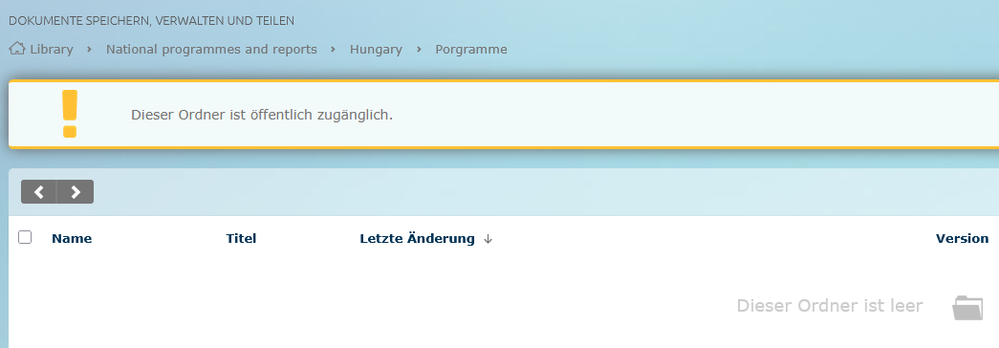
National programmes and national reports
Requirements of Directive 2011/70/Euratom
National programme for the implementation of the national policy: first one was due in 2015, and needs to be updated at least every 10 years
A national report shall be submitted to EC every 3 years
Content of the national programme is defined in Art. 12: national policy, milestones and timeframes, inventory, concepts for all steps of management, concepts for post-closure phase of final repositories, research, responsibilities, costs and financing, transparency policy, agreements with other states for shared solutions/export
Evaluation
EC did not want to publish the national programmes from the beginning; Nuclear Transparency Watch (NTW) had to make request for access
EC now has a website where all national programmes and reports should be published – but no programmes for some countries (f.e. Hungary, Bulgaria), and for some only in the country’s language and not in English:
Necessary improvements
Keeping the website of EC up-to-date
EC should provide national programmes also in English

Slide 7
Transparency and participation
Requirements of Directive 2011/70/Euratom
Art. 10 (1): Member States shall ensure that necessary information on the management of spent fuel and radioactive waste be made available to workers and the general public.
(2): Member States shall ensure that the public be given the necessary opportunities to participate effectively in the decision-making process
Evaluation
A Strategic Environmental Assessment (SEA) is obligatory for a programme like the national programme, to assess environmental impacts and enable participation. It is a legally secured participation instrument under the Espoo Convention and EU law.
But: No SEA was conducted for about half of the national programmes; therefore, no legally secured participation was enabled for national and transboundary public. Argument was that Euratom was not under EU SEA law.
A SEA is conducted in the concept phase, and should be conducted again when the national programme undergoes significant changes
Participation is also needed during operation of nuclear waste facilities; but if there is participation enabled, it is often restricted to local communities
Necessary improvements
The Nuclear Waste Directive needs to define “effective participation” in a better way, amongst others clearly linking it to the Espoo and Aarhus Convention and the EU EIA and SEA laws.
Participation should be enabled not only before operation of facilities, but also during operation, f.e. linked to Periodic Safety Reviews (PSR)

Slide 8
Costs and financing
Requirements of Directive 2011/70/Euratom
Art. 9 obliges EU member states to ensure that adequate financial resources are available when needed. Article 4 (3)(e) defines that “the costs for the management of spent fuel and radioactive waste shall be borne by those who generated those materials”.
According to Art. 12 (h) and (i) the member states are obliged to report on costs, cost assessment methodology and financing schemes in the national programmes.
Evaluation
Many member states do neither have reliable data about the future costs of their nuclear programmes´ back-end nor the financial means to cover them.
This is also recognized by EC: “The assessment of costs is sometimes out-of-date or not comprehensive, therefore impacting the effectiveness of financing schemes with a risk that they will not be sufficient to cover the costs.” (see report of EC COM(2024)197, p. 16)
Moreover, the EC recognizes that “it is apparent that the Directive has not been effective as regards its rules that aimed to create conditions for fully ensuring the availability of adequate financial resources for spent fuel and radioactive waste management, including radioactive waste from decommissioning activities, when needed.” (ibid., p. 11)

Slide 9
Costs and financing
Example: estimated costs for a deep geological repository (DGR) for high level waste: The estimated costs vary significantly between countries. This might be explained with different methods of cost assessment.
Necessary improvements
Art. 9 needs to be amended:
Costs need to be updated in regular intervals. They need to be based on realistic assessments with publicly available data; outdated data are not acceptable.
Full transparency on financing (funds) is needed.
Guidelines will be needed to make the member states’ data transparent and comparable.
Country | Tons heavy metal (t HM) expected until final disposal | Costs assessed for DGR in bn Euro | Costs per t HM in million Euro
Czech Republic | 9,910 (in or after 2085) | 11.23 | 1,13
France | 16,956 (in 2040) | 33.4-37 | 2.01-2,18
Slovenia | 842 (in 2040) | 1.14 | 1.35
Sweden | 12,000 (in 2050) | 3.2 | 0,27
Finland | 6,500 | 5 | 0,77

Slide 10
Other issues
Long-term interim storage: no final repository means that HLW has to be stay in interim storages; problems of life-time extension, but the old ones were not designed for long lifetimes (up to or more 100 years) problems with ageing, outdated designs (f.e. less security against drone attacks), transparency and participation
Shared solutions (multinational repositories, etc.): might be a way to avoid national decisions for national repository
…

Slide 11
Consultation is open until 19 June
https://ec.europa.eu/info/law/better-regulation/have-your-say/initiatives/14619-Radioactive-Waste-Directive-and-Shipments-Directive-evaluation_en
Consultation is open until 19 June
You have to sign in via EU-Login
Joint Project will produce a statement which can be signed
Goal is that many statements are submitted, they should differ from each other (EC will count the same statements as one)

Slide 12
Contact
Thank you for your attention!
Directive 2011/70/Euratom: https://eur-lex.europa.eu/legal-content/EN/TXT/PDF/?uri=CELEX:32011L0070
Contact: mraz@ecology.at, patricia.lorenz@foeeurope.org
https://www.joint-project.org/
https://www.dont-nuke-the-taxonomy.eu/

