Slide 1
Results (2024) from Investigation about new nuclear financing and risk sharing
What asked the government for?
“To design a model so that nuclear power with a total capacity of at least 2,500 MW, equivalent to the capacity of two large-scale reactors, will be in place by 2035 at the latest.”
What did they get?
“The model is intended to finance a nuclear program of 4 000–6 000 MW (4 reactors of same type and at the same place), to contribute to a total of 300 TWh electricity generation in 2045 in Sweden.”
- 4 reactors needed to produce enough electricity to finance investments in nuclear waste disposal site
- At least 300 MW per reactor
Estimated cost:
40 billion Euro (400 billion Swedish Crowns) – 8 million Euro / MWh

Slide 2
Results (2024) from Investigation about new nuclear financing and risk sharing
Proposal for financing
State loan: 75% = 30 billion Euro with lower interest rate than market would offer. The interest rate on the state loans is gradually raised during the operating phase to provide an incentive to replace the state loans with market financing.
A 2-way CfD is signed between the state and the nuclear power producer: at 0,07 Euro/kWh (80 öre) for 40 years
Risk and gain-share mechanism that gives investors a minimum return on equity. The mechanism is activated based on the result of a market valuation of the project 2 years after the nuclear power plant has entered the operational phase

Slide 3
Results (2024) from Investigation about new nuclear financing and risk sharing
How to implement?
Next step is a new law to give the government right to subsidize new nuclear with no right to appeal decision
Proposal: to authorize the government to decide on loan , which amounts to a maximum of SEK 600,000,000,000 (maximum 75 percent of investment costs, including a reserve for cost overruns up to 100 percent).
CfD costs are planned to be covered by all power customers; at least 70% of produced electricity has to be sold to open power market (in case of PPA signed)

Slide 4
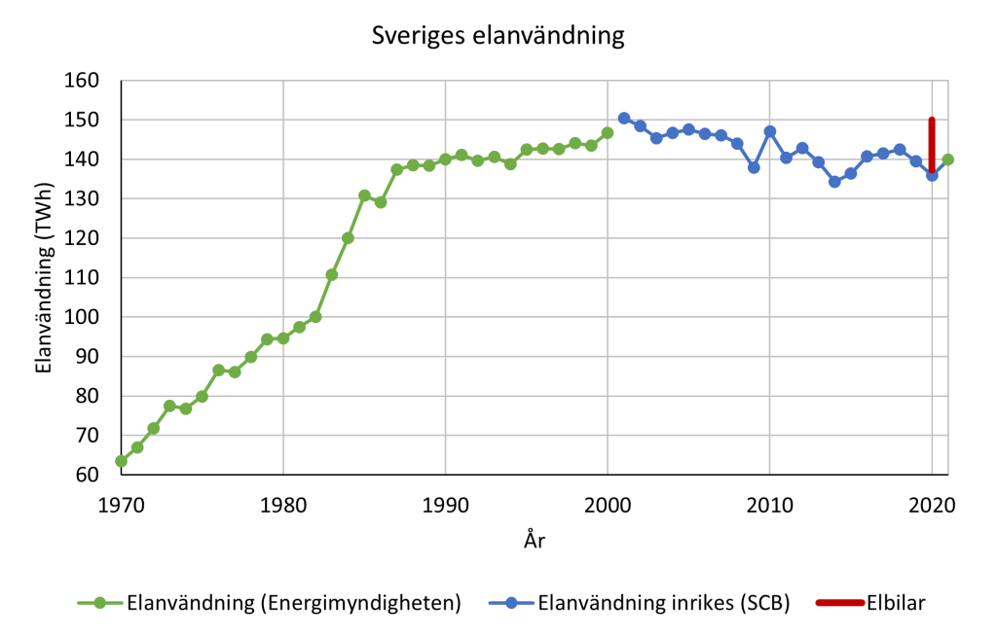
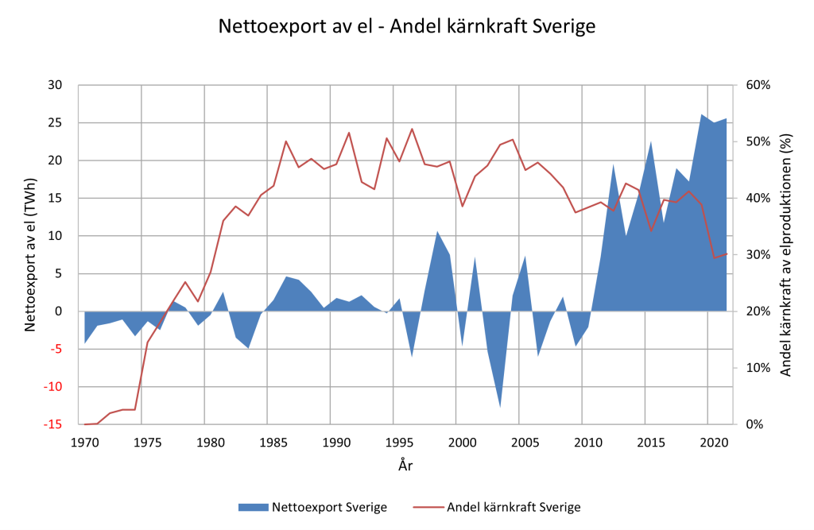
Sweden electricity use and net import
Data från Svenska Kraftnät / SCB / Energimyndigheten

Slide 5
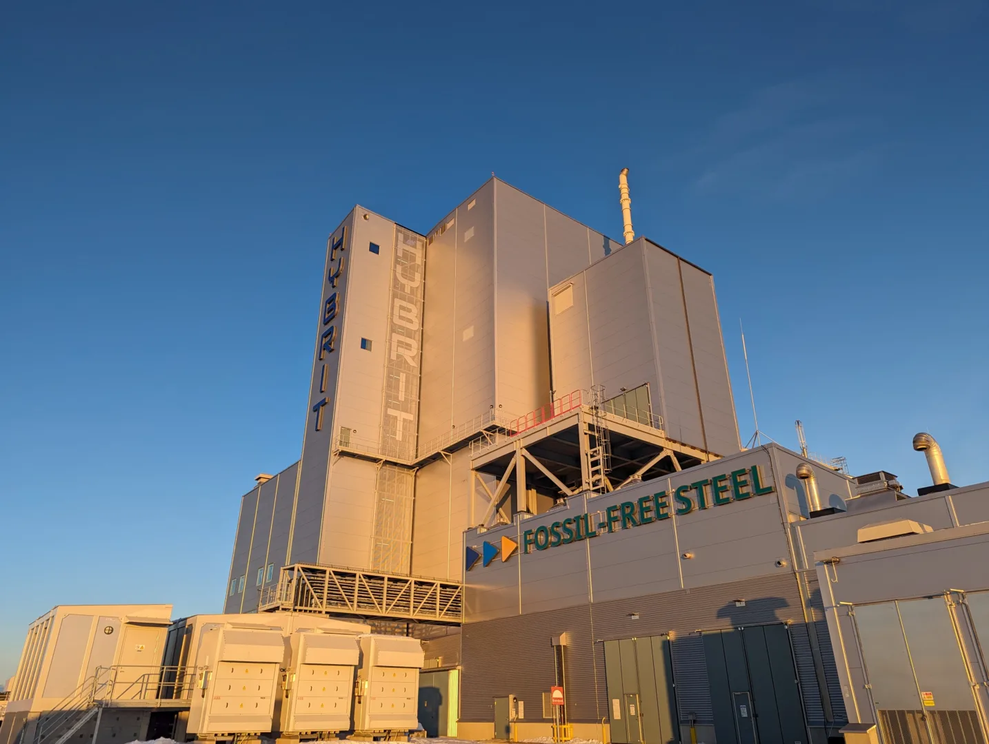
Green transition projects in
North Sweden
Green steel projects and Fossil-free fertilizer projects
demand about 70-100 TWh of electricity / yr – 1 – 1.5 times more than Austrias total final electricity use 2022 (about 66 TWh).
https://www.hybritdevelopment.se/

Slide 6
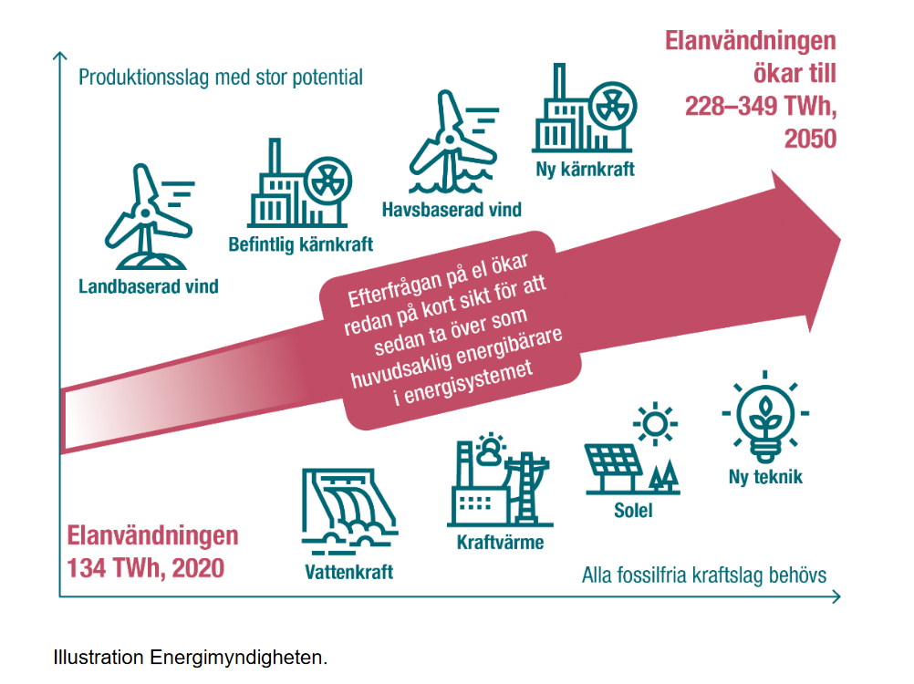
Future electricity demand - Scenario
www.energimyndigheten.se/49428c/globalassets/statistik/prognoser-och-scenarier/langsiktiga-scenarier/langsiktiga-scenarier-over-sveriges-energisystem-2023.pdf
Enegieffektiviseringsdirektivet?

Slide 7
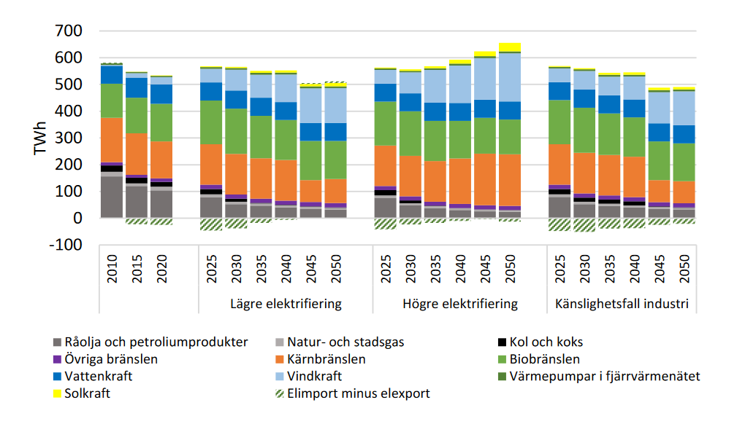
Swedish energy system scenarios
www.energimyndigheten.se/49428c/globalassets/statistik/prognoser-och-scenarier/langsiktiga-scenarier/langsiktiga-scenarier-over-sveriges-energisystem-2023.pdf

Slide 8
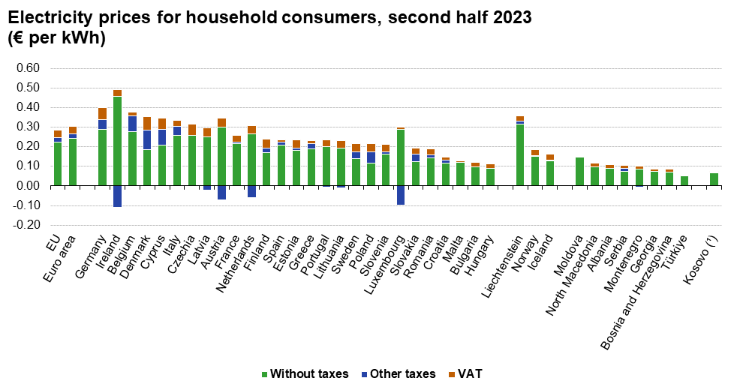
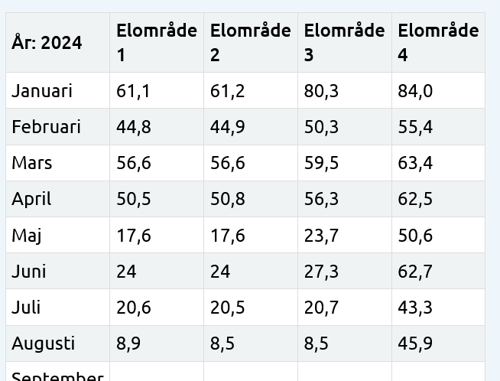
Swedish electricity prices
https://ec.europa.eu/eurostat/statistics-explained/index.php?title=File:Ele_map_2023_S2_V1.png

